Slide 1
Analytics using Cloud Services
Twitter Sentiment Stream Analytics in Azure
Project by:
Roshik Ganesan
Vignesh Srinivas
Kaustubh Padhya

Slide 2
Table of Contents
Objective
Pre-requisites
Process Flow
Components
Summary
Limitations
Web References
Q & A

Slide 3
Objective
To showcase the ease and power of Analytics using Cloud by demonstrating real-time Twitter streaming sentiment analysis using Twitter API Client and MS Azure services like Event hubs, Stream Analytics, Power BI.

Slide 4
Pre-requisites
MS Azure account (Free Trial subscription)
Twitter Account and OAuth access token
Twitter WPF client API

Slide 5


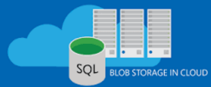


Process Flow
Twitter
Twitter WPF Client (Sentiment Score)
Event Hub
Stream Analytics
Blob Storage
Power BI Dashboards

Slide 6
Twitter WPF Client
This application connects to twitter database to collect the tweet events based on specified Hash-Tags
The Sentinment140 open source tool assigns sentiment to the tweets as follows.
0 – Negative
2 – Neutral
4 – Positive
The twitter access keys and EventHub connection string has to be fed to the application to retrieve data and store events in EventHub.

Slide 7
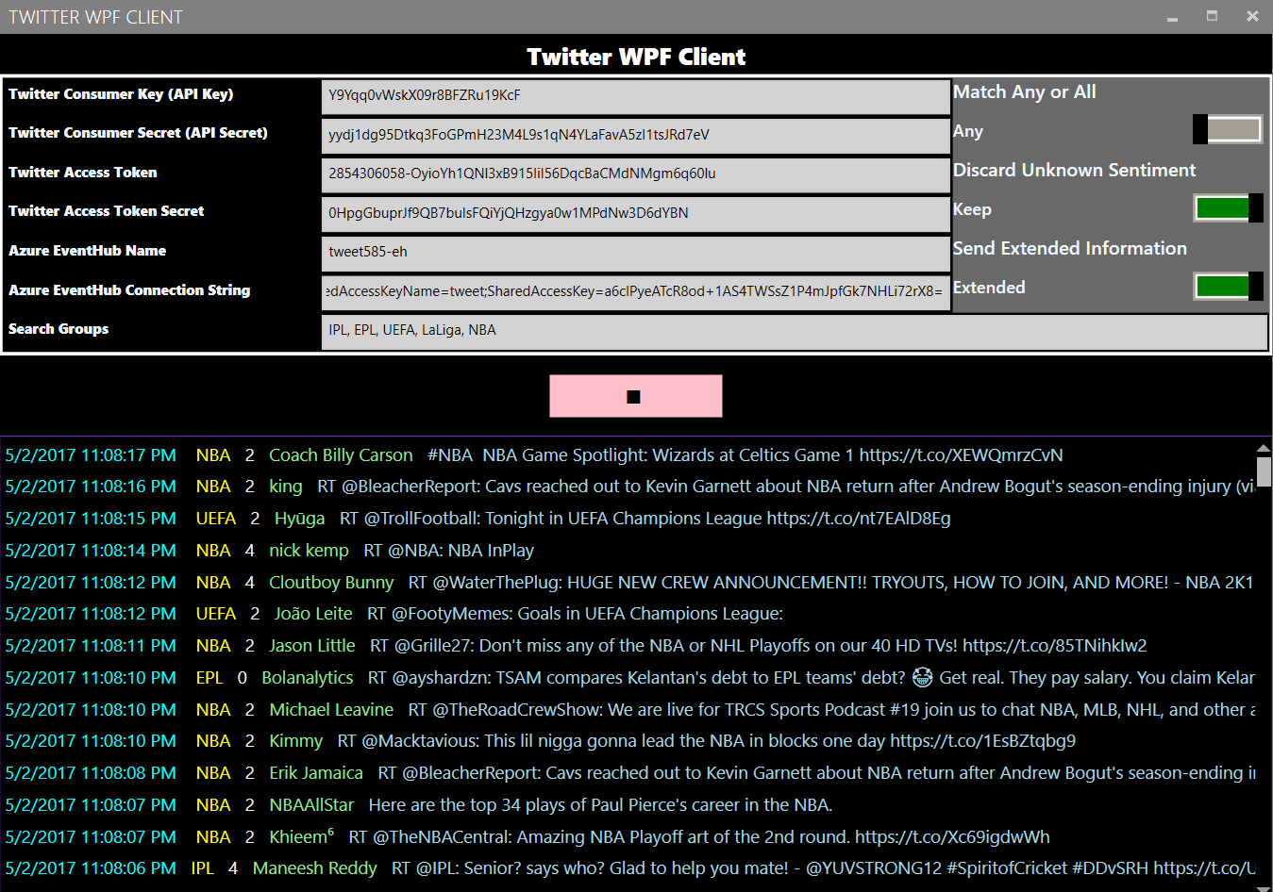
Twitter WPF Client Overview

Slide 8
Event Hubs
Azure Event Hubs is a ingestion service that collects, transforms, and stores millions of events.
Event Hubs is a fully‐managed service that ingests events with elastic scale to accommodate variable load profiles and the spikes.
As a streaming platform, it gives you low latency and configurable time retention, which enables you to ingress massive amounts of data into the cloud and read the data from multiple applications using publish‐subscribe semantics.
Event Hubs Archive is the easiest way to load data into Azure.

Slide 9
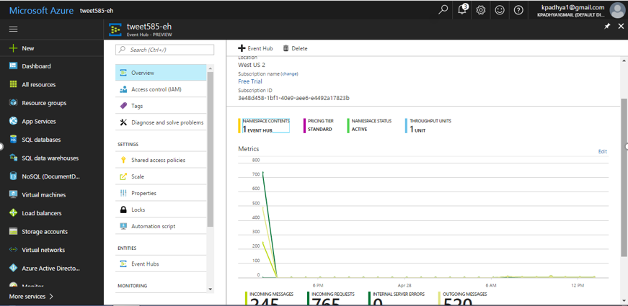
Event Hub Overview

Slide 10
Stream Analytics
Easily develop and run massively parallel real‐time analytics on multiple IoT or non‐IoT streams of data using simple SQL like language.
Get started in seconds because there is no infrastructure to worry about, and No Servers, Virtual Machines, or Clusters to manage.
Scale‐out the processing power from one to hundreds of streaming units for any job.
Create powerful real‐time analytics using very simple declarative SQL like language.

Slide 11
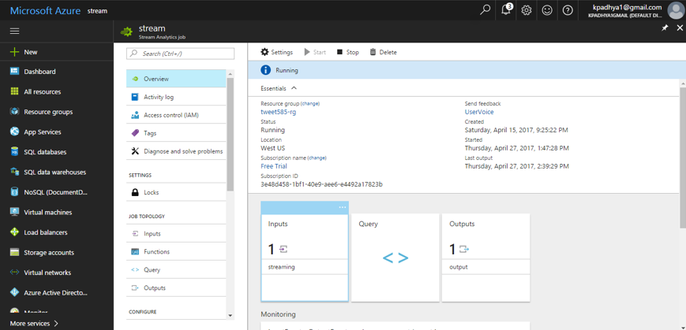
Stream Analytics Overview
INPUT
QUERY
OUTPUT

Slide 12
Blob Storage
Blob storage can handle all of your unstructured data, scaling up or down as your needs change. You no longer have to manage it, and you only pay for what you use, and save money over on‐premises storage options.
This is the final storage space in Azure where the unstructured data is stored after being pulled using the stream analytics job.
Benefits:
Strong consistency
Object mutability
Multiple blob types
One infrastructure, worldwide access

Slide 13
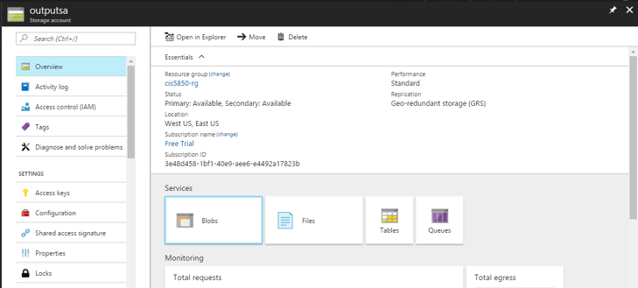
Blob Storage Overview

Slide 14
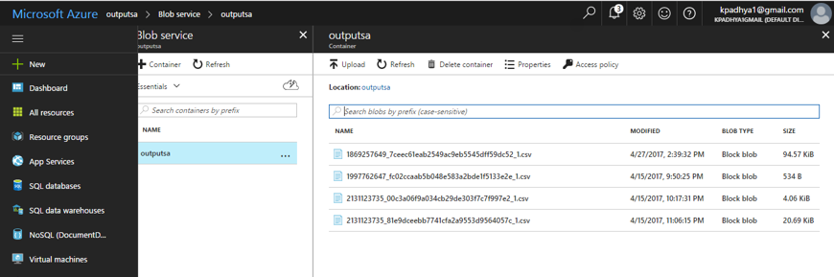
Blob Storage Overview

Slide 15
Power BI Dashboards
Quickly build real‐time dashboards with Power BI for a live command and control view. Real‐time dashboards help transform live data into actionable and insightful visuals.
Using Power BI desktop app a connection is established between the Power BI and the Azure Blob Storage.
The Power BI dashboard is built using the Power BI Cloud Platform (app.powerbi.com).
Automatic refresh window for every 30 minutes is configured.

Slide 16
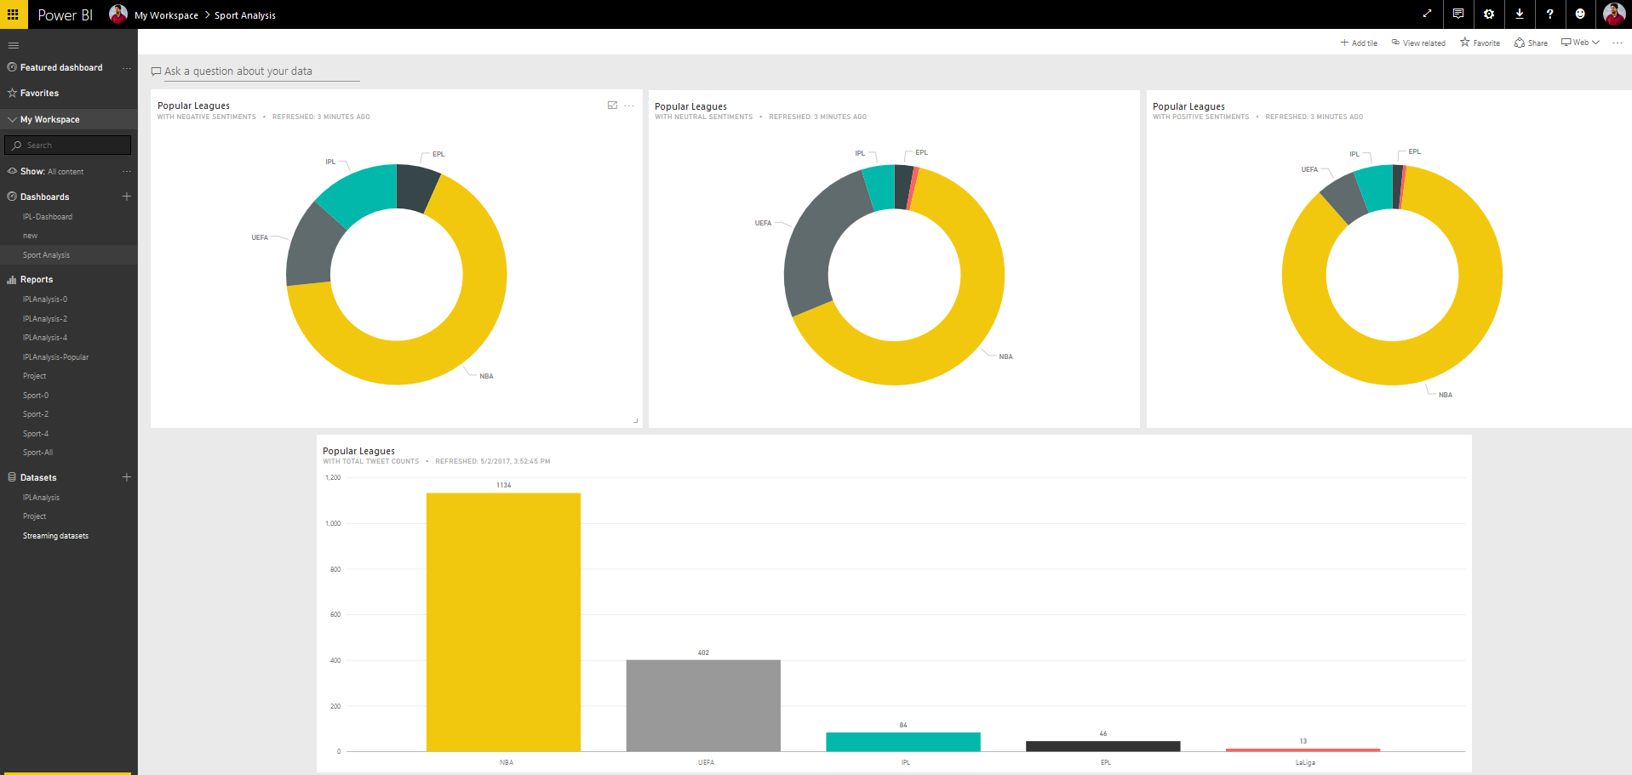
Power BI Dashboard Overview

Slide 17
Summary
Using Microsoft Cloud Services like Azure Stream Analytics and Power BI the current twitter sentiment analysis of the Popular Sports leagues around the world is conducted.
The sentiments and popularity of various leagues are analyzed based on the current tweets in the Twitter platform.
Hash-Tags Used:
IPL, EPL, UEFA, LaLiga, NBA

Slide 18
Limitations
Azure Blob storage has been used to store the streaming data as it is a part of free tier subscription.
Given the flexibility of using a SQL server database or SQL data warehouse a better analytics could have been done with structured data.
Using Power BI pro edition Real-Time dashboard refresh could be achieved avoiding the 30 minutes refresh window.

Slide 19
Web References
https://docs.microsoft.com/en-us/azure/event-hubs/event-hubs-what-is-event-hubs
https://docs.microsoft.com/en-us/azure/stream-analytics/stream-analytics-introduction
https://docs.microsoft.com/en-us/azure/stream-analytics/stream-analytics-power-bi-dashboard
http://help.sentiment140.com/

Slide 20
Question and Answer Session
Thank You

